Slide 1

Presentation Title
September 16, 2015
Chapter
Opening
What’s New with IBM UrbanCode Deploy
Thursday, April 6th 2017
WEBCAST LINK: http://event.on24.com/wcc/r/1355024/C879250D4B23E59C2137884F053FE7CF

Slide 2
Todays Speakers
Laurel Dickson-Bull
Product Manager, IBM UrbanCode Deploy
Steve Boone
Product Owner & Development Manager, IBM UrbanCode Deploy

Slide 3
In This Presentation
01
UrbanCode Mission
02
Better with Cloud
03
New UrbanCode Services
04
Transitioning to the Cloud
05
What’s new in 6.2.4
06
Demo
07
Q&A

Slide 4
The UrbanCode Mission: To enable clients to continuously deliver applications with high quality and low risk

Slide 5
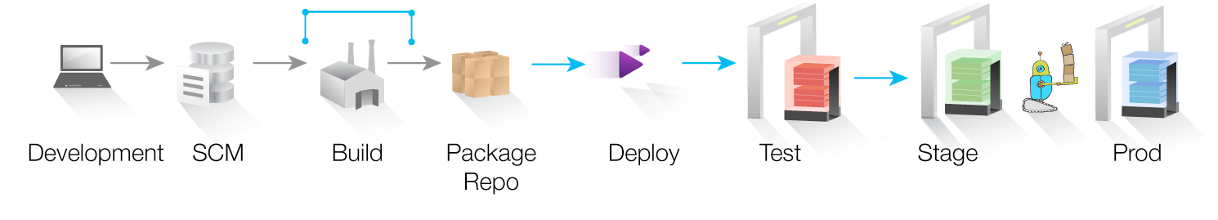
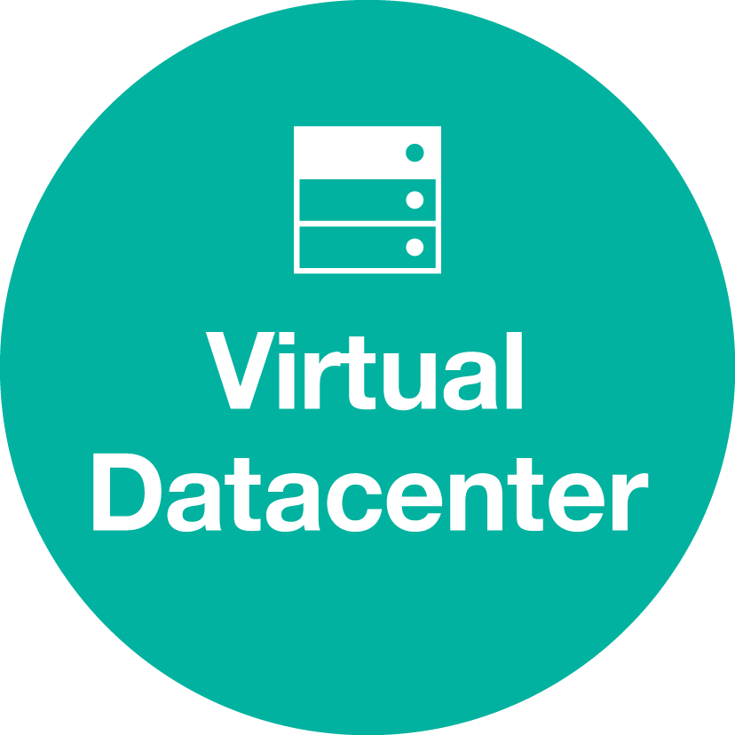



Available Solutions
UrbanCode Build
Core Benefits
Speed time to market
UrbanCode Deploy
UrbanCode Release
Continuous Integration that scales
Full-stack deployment automation for applications
Collaborative release management across many apps
Simplify audit
Reduce the risk of change
Do it all at scale

Slide 6
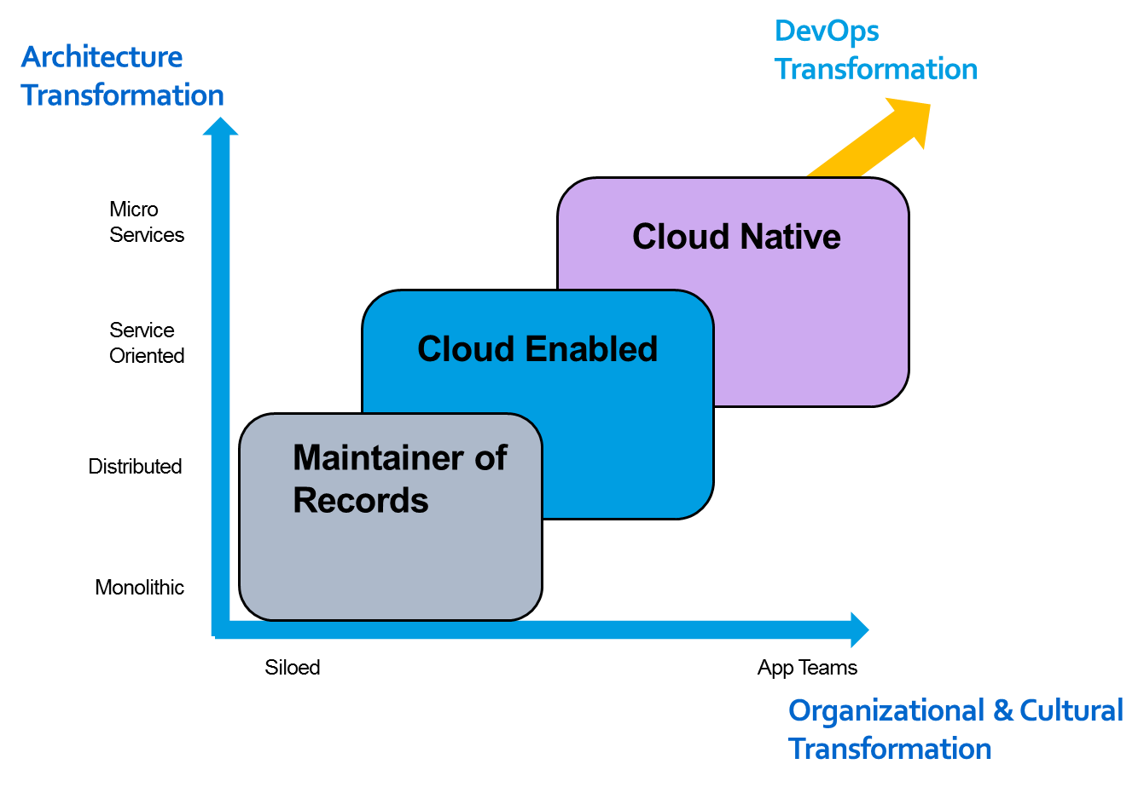
Enterprises have varying levels of maturity

Slide 7
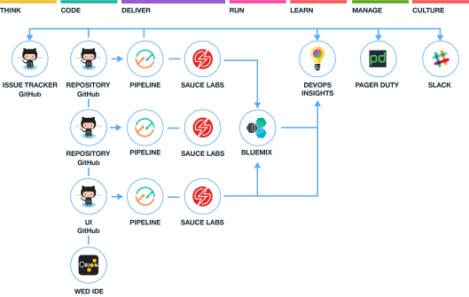
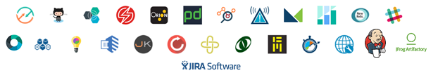

For Cloud Native, we provide an open toolchain.
A sample open toolchain for building, and deploying and managing three microservices
Toolchains provide an integrated set of tools that support the best practices to build, deploy and manage your apps.
You can create toolchains that include Bluemix services, open source tools, and third-party tools that make development and operations repeatable and easier to manage.
Rapidly instantiate new toolchains from templates to on-board new teams quickly.

Slide 8
UrbanCode is better with Cloud
Integrated with toolchain services
Good for hybrid workloads
Good for enhancing your core UC experience

Slide 9





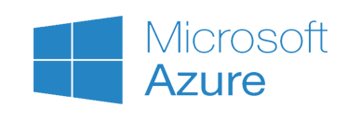
Architecturally, it looks like this
Bluemix
Mobile Services
DevOps
Insights
Continuous Release
CI/CD
Pipeline
Cloud Automation
UC Mobile
App
Open Toolchain
DevOps Connect
UrbanCode
Build
UrbanCode
Deploy
UrbanCode
Release
Virtual Datacenter
Private
Public
VMware vCenter
IBM CONFIDENTIAL

Slide 10
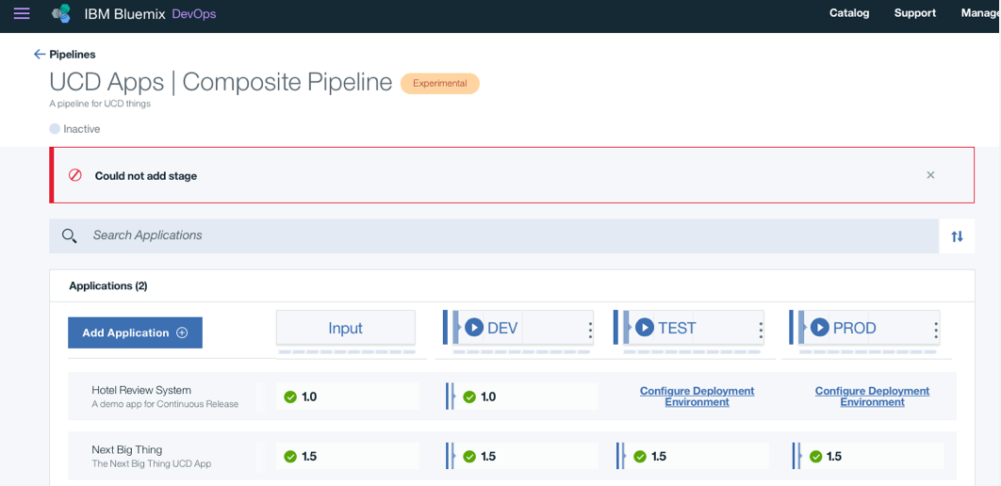
Continuous Delivery
Pipeline view for what’s where
Includes UC Deploy content
Provides automation for cloud native workloads like Cloud Foundry and Containers
Value add for cloud native dev
Git repos
WebIDE
Easily create a DevOps toolchain
Key Goals:
Consistently build and deploy cloud native software
Provide a simple pipeline view for both reporting and acting
Notes:
Release Management teams have key goals when it comes to managing those Integrated Releases.
We’ll discuss key aspects of how UrbanCode Release help streamline the release process.

Slide 11
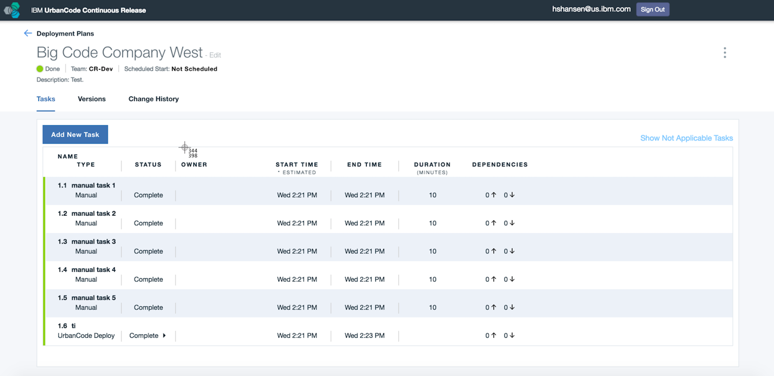
Continuous Release
“Streamline the release process: eliminate waste, increase visibility”
Plan release deployment
Standardize release deployment activities
Orchestrate release deployment & track progress
Reduce risks through quality enforcement & managing dependencies
Enforce governance
Key Goals:
Reducing the amount of labor to prepare and execute for a release
Reduce the outage windows due to release deployment process
Reduce the application downtime due to quality issues
Notes:
Release Management teams have key goals when it comes to managing those Integrated Releases.
We’ll discuss key aspects of how UrbanCode Release help streamline the release process.

Slide 12
DevOps Insights
Delivery Insights
Insights into continuous delivery cycle times, delivery metrics, dashboards and reports, hybrid data from Bluemix and UCD on-premises with mobile support
Deployment Risk Insights
Continuous Delivery Control Center dashboards, automated test result analysis and Policy Gates to determine readiness for production deployment
Developer Insights
Error prone file analysis during development, based on production outages, user skill, and volume of changes

Slide 13
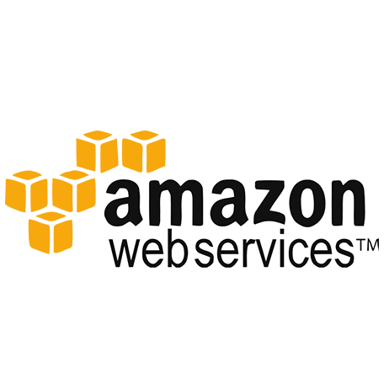


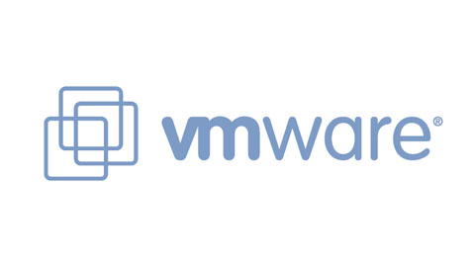
Helping customers transition to the Cloud

Slide 14
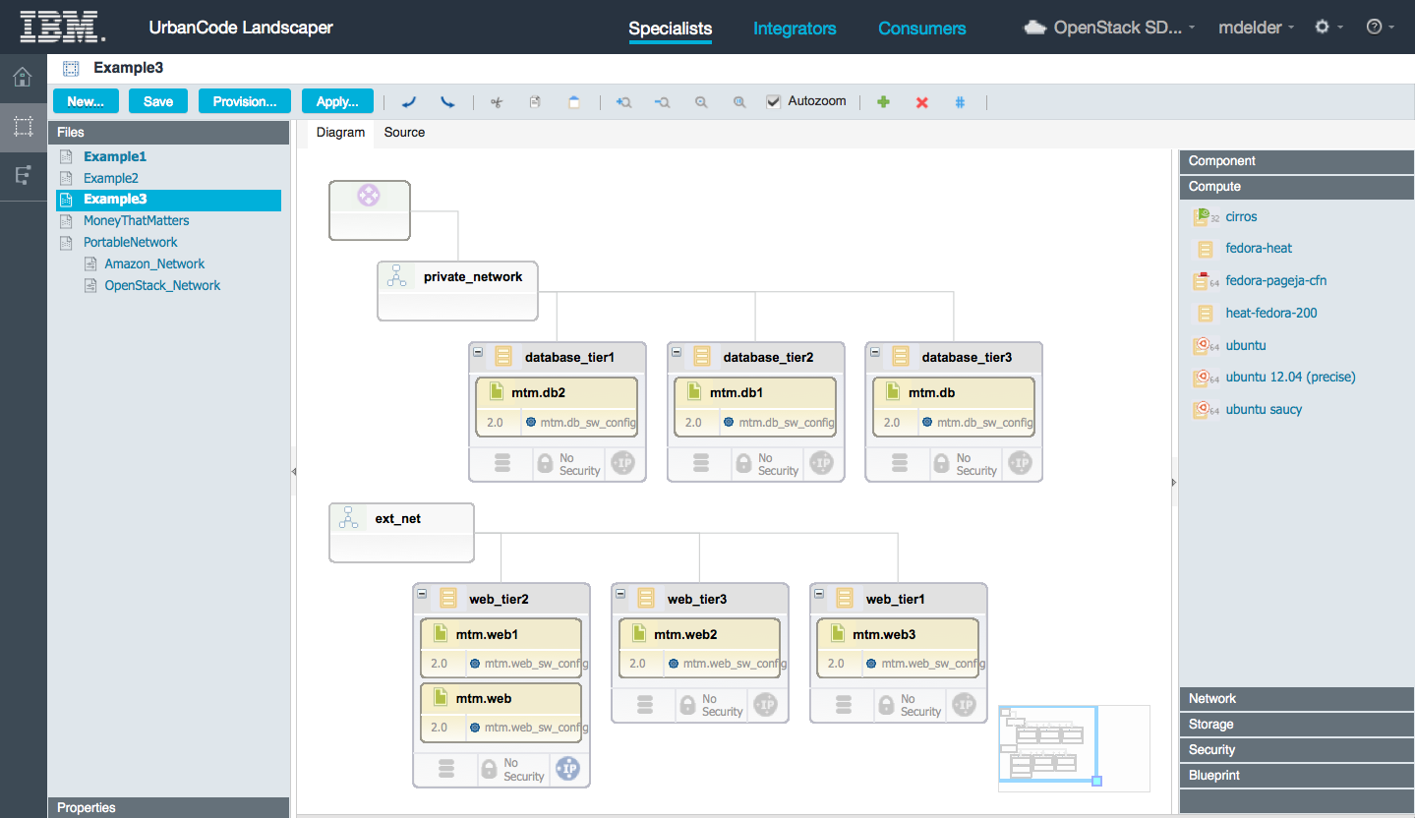
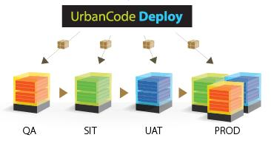
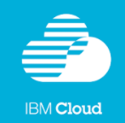

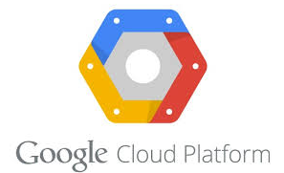
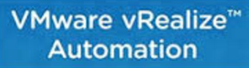
UrbanCode Deploy Blueprint Designer
Full stack Application Design & Provisioning
Design open, full stack application environments from diagram or source
Portability to heterogeneous clouds
Capture the expertise of a heterogeneous DevOps team, from solution architects to IT specialists
Hybrid clouds: Blend your application with PaaS, SaaS, and Traditional IT
Enables you to balance speed, cost, and flexibility according to your specific needs
Continuous Delivery of Applications into the Cloud
Eliminate weeks of waiting for new environments when starting new projects or testing new app changes
IBM UrbanCode Deploy
Blueprint Designer
VMware vCenter

Slide 15
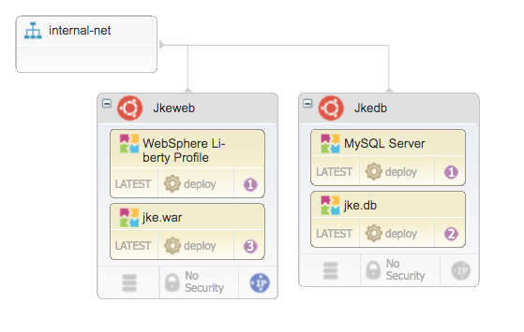
Cloud Platform Support
Utilizing OpenStack Heat
Heat orchestration document
Cloud Portability
Avoid vendor lock-in
Provision the same blueprint to multiple cloud platforms
Public:
Amazon Web Services, Microsoft Azure, IBM Cloud (SoftLayer), Google Cloud Platform
On-Premises:
vCenter, vRealize Automation, OpenStack
Compatible with OpenStack-based IBM Cloud Offerings
IBM Cloud Orchestrator (ICO)
IBM BlueMix Local (BlueBox)
Ships with Heat integration for UrbanCode Deploy
Provision
VMware vCenter

Slide 16
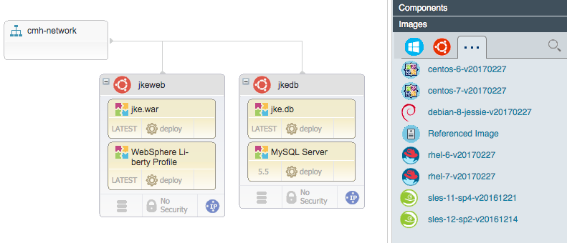
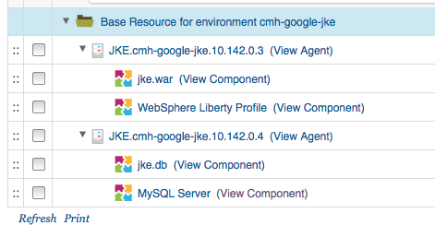
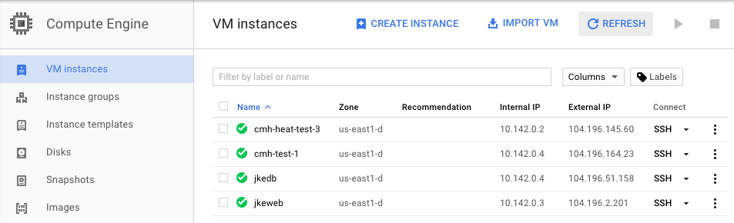
Google Cloud Platform Support
Create full-stack blueprints for GCP
Virtual machines (public, private)
Networking, public IP addresses
Disk creation and attachment
UCD components
Direct provisioning (no cloud-init)
New environment and deployment in UCD
New infrastructure in GCP

Slide 17
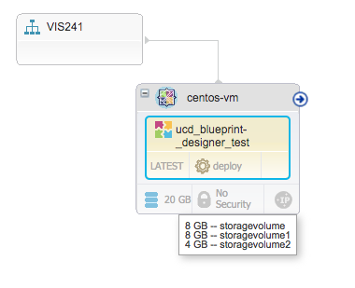
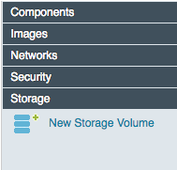
VMWare Enhancements
Multiple Enhancements to vCenter and vRA support
vCenter: Add multiple disks to VM
vCenter: Use DHCP networking
vCenter: Provision via Vmware tools
(no cloud-init)
vRA: Specify custom machine prefixes
vRA: Improved request property management

Slide 18
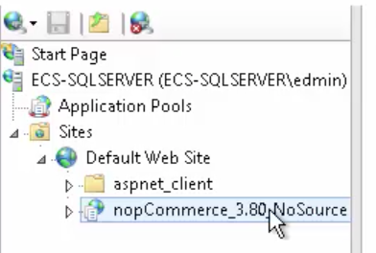
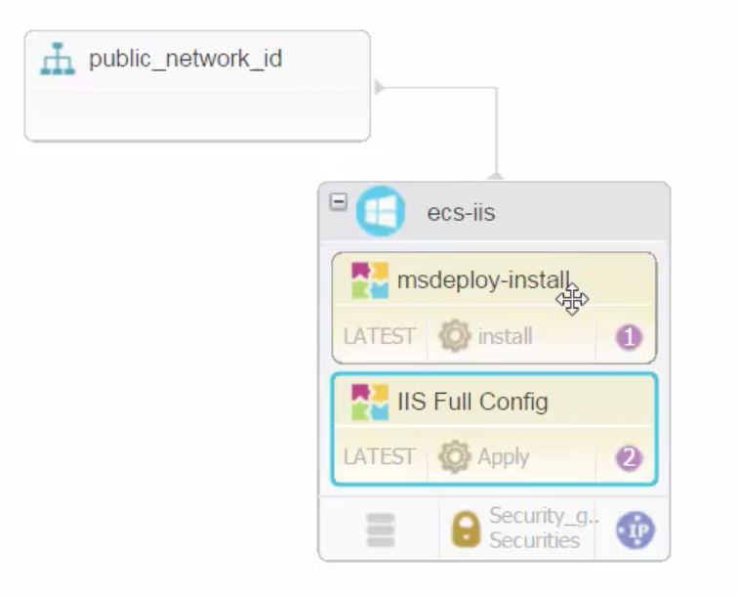
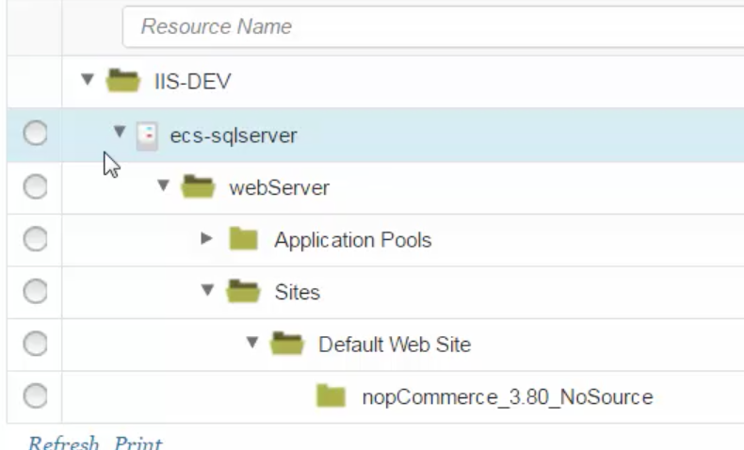
Migrating IIS Workloads to the Cloud
UrbanCode Deploy supports migrating IIS workloads to various cloud platforms
Use IIS Configure plugin in UCD to discover topology of IIS configuration
Create UCD blueprint with topology component and provision to cloud
AWS, Azure, etc.
Provision to Cloud
Create Blueprint
Discover Topology

Slide 19

IBM
Presentation Title
September 16, 2015
12
Chapter
Opening
IBM UrbanCode 6.2.4

Slide 20
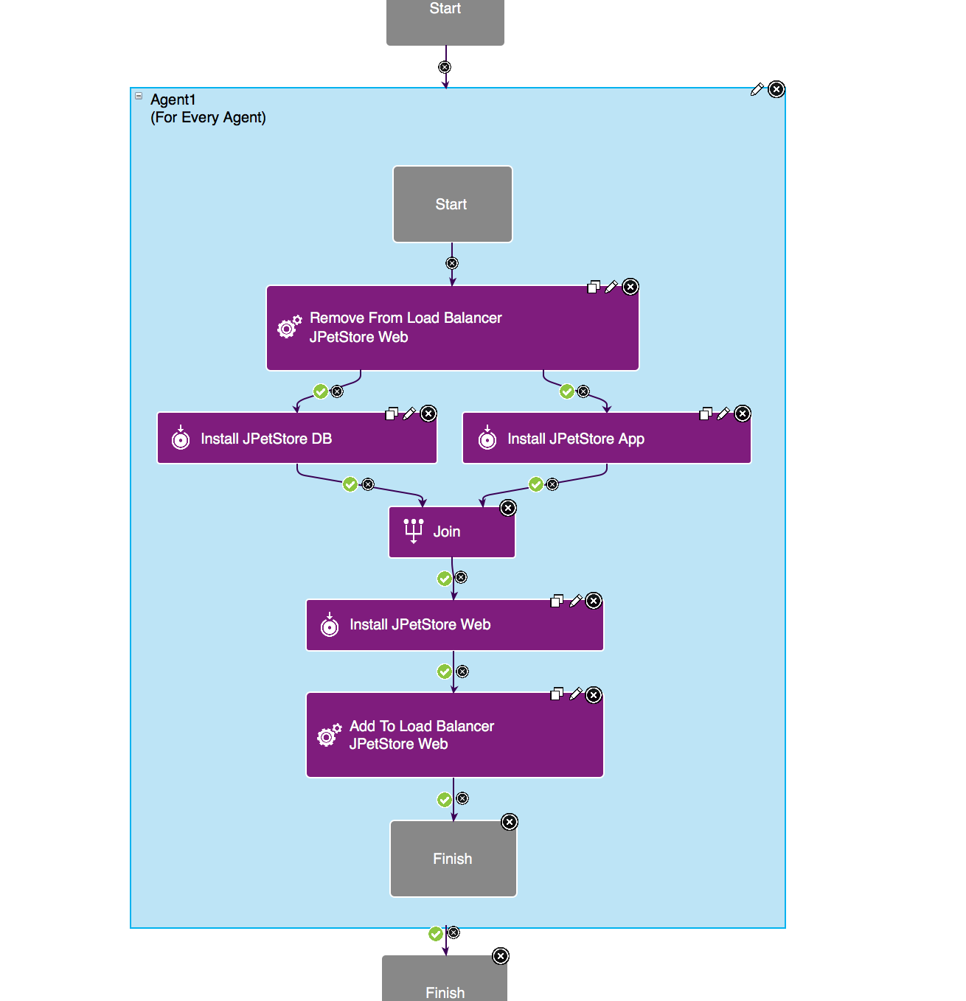
Dynamic Tag Support and
Advanced Rolling Deployments
Wrap a process with a “For Each Tag” Box
Deploy to Multiple Tags
Drag and Drop ordering of Tags

Slide 21
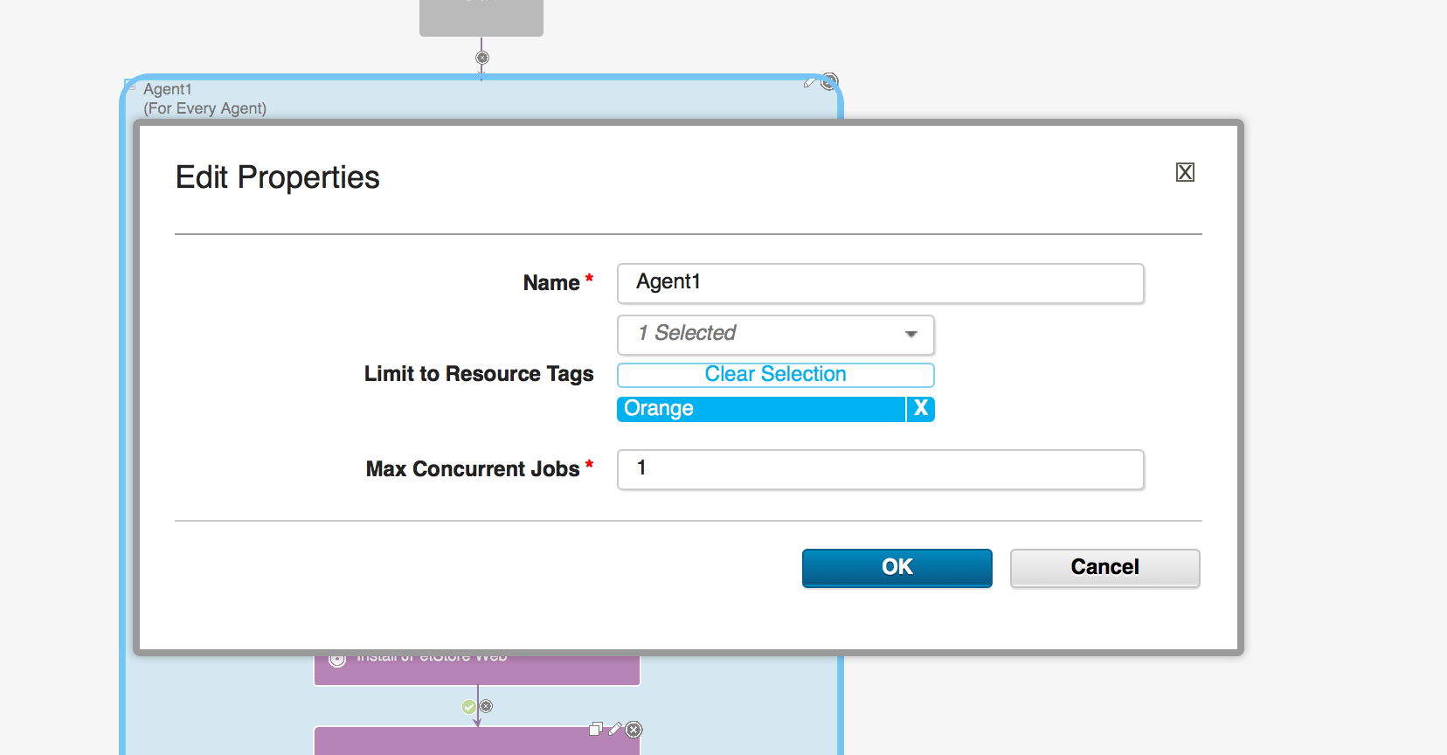
Max Concurrent Agents

Slide 22
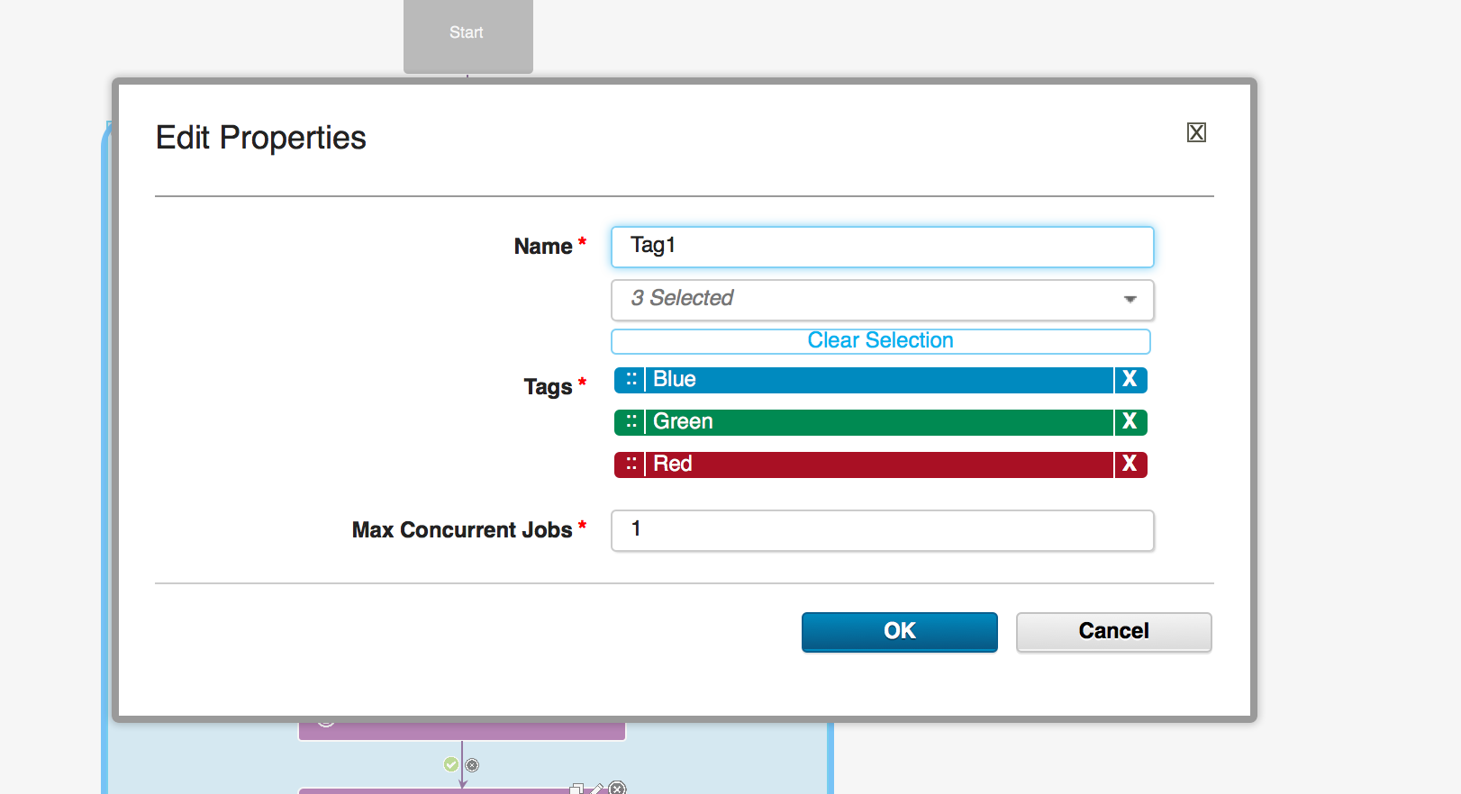

Slide 23
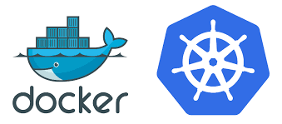
Growing our Container Support
Done: Docker Support - Docker Trusted Registry and IBM Containers as a source type. Automation to deploy Docker image. Support for Docker Compose.
Done: Initial support for OpenShift, Meso Marathon and Kubernetes
Ongoing: Additional refinements to these plugins including Docker Swarm and Docker Data Center.
Future: Blueprint designer container support

Slide 24
Questions?

